Slide 1
Memory Locations and Addresses:
How memory is organized?
Memory has millions of storage cells
Each cell can store only a bit (Either 0 or 1)
Bits are rarely handled individually
Instead handled in groups of fixed size
Words
This can be stored or retrieved in a single operation
Memory---Collection of words

Slide 2
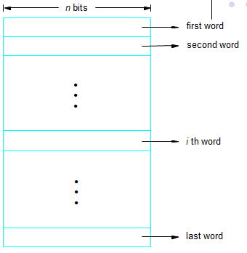
Continued…
Memory Words

Slide 3
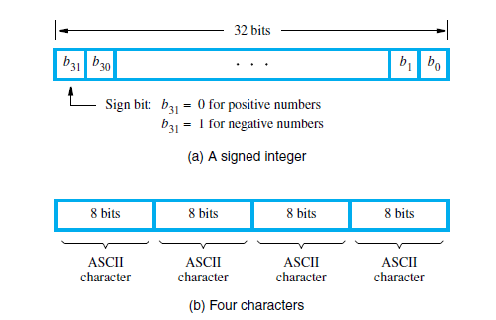
Continued…
Word lengths vary from 8—64 bits
ASCII--- 8 bits are used to represent a character
A single word (length=32 bits) can store a 32-bit 2’s complement number
A single word (length=32 bits) can store 4 characters

Slide 4
Continued…
Why do we need addresses?
To access a word/or a byte we need distinct names or addresses
____ bit address is required to address 2^24 locations
Range of addresses? Address space?
Suppose if the memory of a machine has 2147483648 words (1 word=2 bytes) then ________ bit address is required to address all the locations?
1 KiloBytes=1K=1024 bytes=2^10
1 MegaBytes=1M=1024K=2^10*2^10=2^20
1 GigaBytes=1G=1024M=2^10*2^20=2^30
1 TeraBytes=1T=1024G=2^10*2^30=2^40

Slide 5
Continued…
Byte Addressability:
1 byte = 8 bits always
But not that 1 word=2 bytes always
It depends on word length
Word length—16
1 word=2 bytes
Word length---32
1 word=4 bytes
Word length—64
1 word= 8 bytes
Rather addresses are assigned for every byte. It is called Byte addressability

Slide 6
Continued…
Big Endian and Little Endian Assignment:
Let’s say 1 word=2 bytes i.e, 1 word=16 bits
ALU is 16-bit and Registers—16 bits
EX: 1
How this ABCDH will be stored in memory in Big Endian?
CD which is the lower order byte value is moved to the higher order byte address of that word and AB is moved to lower order byte address of that word
CD is stored in address 0001 and AB in address 0000
How this ABCDH will be stored in memory in Little Endian?
AB in Higher order byte address and CD in lower order byte address
AB in 0001 and CD in 0000
In both addresses for words are not going to change

Slide 7
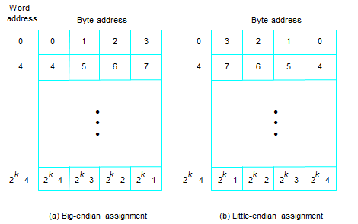
Continued…
Big Endian and Little Endian Diagrams:

Slide 8
Continued…
Word Alignment:
When a word is said to have aligned in memory?
When they begin at addresses that are multiple of the no of bytes that make up a word
If not they are unaligned
Ex 1: 1 word=4 bytes
Then words begin at addresses that are multiples of 4 i.e., 0,4,8,12…
Word boundaries
Ex 2: 1 word=8 bytes How about word boundaries
0,8,16…. (Multiple of 8)

Slide 9
Continued…
Accessing numbers, characters, character strings:
A number usually occupies a word
By giving word address a number can be accessed
A character usually occupies a byte
By giving byte address a character can be accessed
About character string?
Beginning---- we can give the byte address of the first character
Ending----- 1. It is better to have a control character after the actual string that says “End of String” ($)
2. A separate loc that contains the length of string

Slide 10
Continued…
Memory Operations:
2 basic operations: Load (Read/Fetch), Store(Write)
Load operation: transfers copy of contents of ML to processor
The Memory contents are not changed
For load operation, processor sends address and read control signal
Store operation: transfers an item from processor to ML
The memory contents are changed
For store operation, processor sends address ,data and write control signal

Slide 11
Continued…
Instructions and Instructions Sequencing:
A computer must have ins for performing 4 types of operations
Data transfer between memory and processor registers
A/L operations on data
Program sequencing and control
I/O transfers
Some notations are required

Slide 12
Continued…
Register Transfer notation:
Possible locations in transfers may be memory loc, registers, registers in I/O
How to refer to the content of a loc?
By enclosing the name by square brackets
Ex 1: R1<-[LOC]
Meaning?
Ex 2: R3<-[R1]+[R2]
Meaning?
This is Register Transfer notation

Slide 13
Continued…
Assembly Language notation:
We need another notation to represent machine ins
Assembly Language notation
Ex 1: Load R1, LOC
Ex 2: Add R3, R1, R2

Slide 14
Difference between RISC and CISC Instruction sets
RISC:
Each instruction occupies exactly one word in memory
All operands involved in an arithmetic or logic operation must either be in processor registers
Memory operands are accessed only using Load and Store instructions
CISC:
Instructions may span more than one word of memory
Not all operands involved in an arithmetic or logic operation must either be in processor registers
Move in place of Load and Store instructions

Slide 15
Consider the statement
C = A + B
RTN is C ← [A] + [B]
RISC program:
Load R2, A
Load R3, B
Add R4, R2, R3
Store R4, C

Slide 16
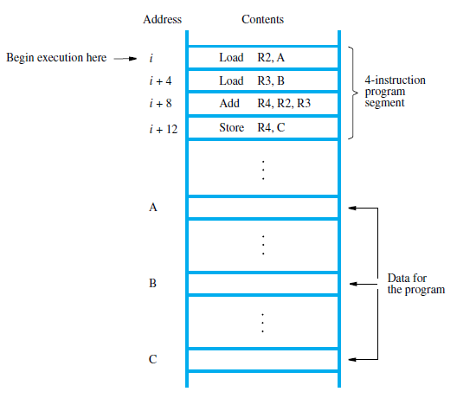
Instruction Execution and Straight Line Sequencing
Program segment for C←[A] + [B],

Slide 17
Continued…
Addresses of 4 instructions are i, i+4, i+8, i+12
Memory is byte addressable and 1 word=4 bytes.
How the program is executed?
To begin execution, the address of first instruction must be placed in PC
With this instructions are fetched and executed one after the other
Straight Line Sequencing
During execution of every instruction PC is incremented by 4 to point to next instruction to be fetched and executed
How an instruction is executed?

Slide 18
Continued…
2 phases
Instruction fetch: Instruction is fetched from memory location and placed in IR of processor
Instruction execution: Instruction is examined for operation and it is performed
PTO

Slide 19
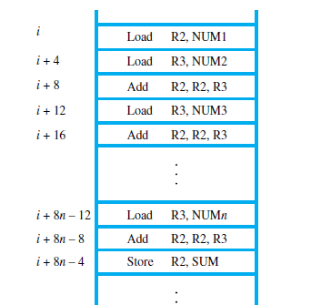
Continued…
Branching:
Problem: Task of adding a list of n numbers
1: Straight Line program

Slide 20
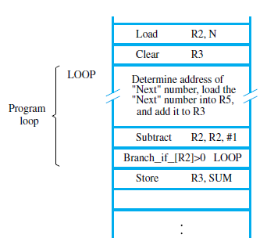
Continued…
Is this a good approach?
2: Instead of this long list, Let’s put add instruction in a program loop

Slide 21
Continued…
Comment---addresses of numbers, N, Sum
Loop:
Starts at LOOP
Ends at Branch>0
Each time thru loop address of the next number is determined , entry fetched and added to R3
How ?
Addressing modes
N contains number of numbers to be added
Moved to R2, R2 is used as counter that determines no of times loop is executed
R2 is decremented by 1 each time in the loop
Loop is repeated till R2 becomes 0

Slide 22
Continued…
Branch>0 LOOP
Branch instruction
Makes the control go to branch target
How?
Up on branching to branch target, PC is loaded with the address of the first instruction of loop
Branch>0 LOOP is a conditional branch
If satisfied, PC is loaded with address of first instruction of loop
If not, PC is incremented in normal way
How long it repeats? (Branch>0 LOOP)

Slide 23
Continued…
RISC Addressing modes:
Immediate
Register
Absolute
Register indirect
Index: Index
Base with Index
Base with Index and Displacement

Slide 24
Continued…
CISC Addressing modes:
Immediate
Register
Absolute
Register indirect
Index: Index
Base with Index
Base with Index and Displacement
Program Counter Relative
Additional modes: Autoincrement and Autodecrement

Slide 25
Continued…
Program operates on data in memory
Data is organized into several structures---Data Structures
Addressing modes: Diff ways in which location of an operand is specified
PTO

Slide 26
Continued…
Immediate mode:
Operand is given explicitly
When the value is not going to change
Application: Constants are represented using this mode
Syntax: #Value
Ex:
Add R4, R6, #200
Register mode:
Name of the register that has the operand is given
Application: Variables are represented using this mode
Syntax: Ri
Effective address: Address from where operand can be determined
EA: Ri
Ex:
Add R4, R2, R3

Slide 27
Continued…
Absolute mode:
Name of the memory location that has the operand is given
Application: Variables are represented
Syntax: LOC
EA: LOC
Ex:
Load R2, NUM1

Slide 28
Continued…
Indirection and Pointers: (Register indirect)
Operand or its address is not given directly
The address of operand is in a register
Syntax: Register indirect: (Ri)
EA: Register indirect: [Ri]
Register or that has address is called pointer
Ex: Next slide

Slide 29
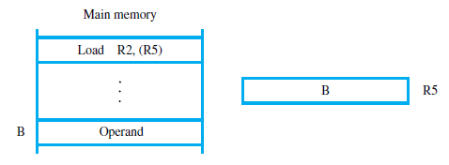
Continued…

Slide 30
Continued…
Register indirect:
First processor reads the contents of R1 and then uses B in R1 as address to obtain the operand
APP: To add successive numbers in the list
Next Slide

Slide 31
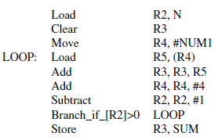
Continued…

Slide 32
Continued…
Indexing and Arrays :
Operand or its address is not given directly
The address of the operand is the content of register(s) together with a displacement value
APP: To deal with arrays and lists
Syntax: Simple Index: X(Ri)
EA: X+[Ri]

Slide 33
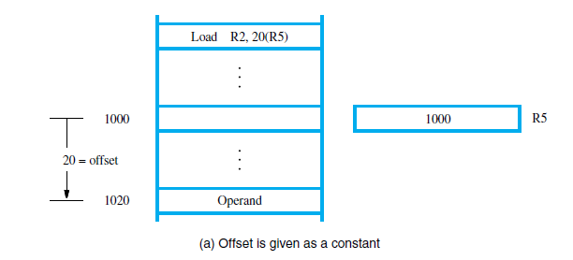
Continued…

Slide 34
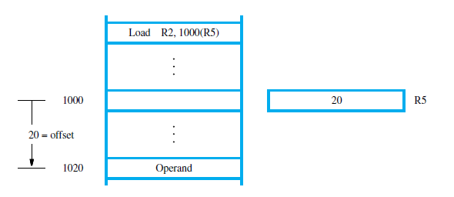
Continued…

Slide 35
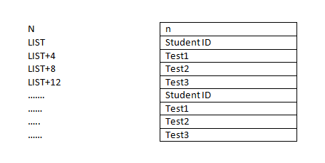
Continued…
PE: Calculating sum of Test Score 1, Test Score 2, Test Score 3 of n students and place results in Sum1,Sum2,Sum3

Slide 36
Continued…
This should be thought of as 2D array
Each row contains entry for a student
Columns give IDs and Test scores
Program in next slide

Slide 37
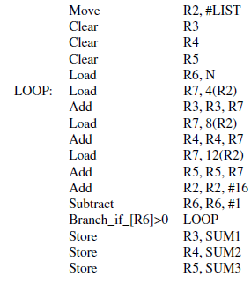
Continued…

Slide 38
Continued…
Content of R4 is changing between records not within records
In the example student ids are the reference points
Base with Index:
Address of operand is the content of Register Ri together with content of register Rj
Syntax: (Ri,Rj)
EA: [Ri]+[Rj]
Actually, One will be an index and other will be a base register

Slide 39
Continued…
Base index with displacement
Address of operand is sum of contents of 2 registers together with a displacement
Syntax: X(Ri,Rj)
EA: X+[Ri]+[Rj]
PTO

Slide 40
Continued…
CISC Instruction Sets:
Most arithmetic and logic instructions use the two-address format
Operation destination, source
Ex1:
Add B, A ; B ← [A] + [B]
Ex2:
Move C, B
Add C, A ; C←[A] + [B]
The general form of the Move instruction is
Move destination, source

Slide 41
Continued…
Relative:
EA of operand is relative to the content of index register
Here the difference is EA of operand is relative to content of PC
Syntax: X(PC)
EA: X+[PC]
X is a signed number because the branch target may be above or below branch instruction

Slide 42
Continued…
Additional Modes:
Auto increment, Auto decrement modes
Autoincrement: EA of operand is the contents of a register
After the operand is accessed, the content of register is automatically incremented by no of bytes that make up a word if I want successive words to be accessed
If I want successive bytes to be accessed then the content of the register will be incremented by 1
Syntax: (Ri)+
EA: [Ri] and Ri is incremented

Slide 43
Continued…
Autodecrement mode:
EA: It is obtained by decrementing the content of register first and then taking the decremented value as address of the operand
Words? Bytes?
Syntax: -(Ri)
EA: Decrement Ri and then EA=[Ri]
These modes can be used to implement stack

Slide 44
Continued…
Condition Codes:
Info about results of various A/L operations must be kept track off
Whether result has generated carry, overflow, result is zero/negative
They are recorded in individual bits called condition code flags
These flags are grouped in a special register called condition code register/flag register/status register
These flags take values 0 or 1

Slide 45
Continued…
Flags:
N-----set to 1 if result is negative
Z-----Set to 1 if result is 0
V----- set to 1 if result has overflown
C----- Set to 1 if a carry results out of A/L operation
These flags are affected as a result of A/L operations
Branch>0 tests N and Z flags to cause a branch

Slide 46
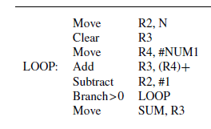
Continued…

Slide 47
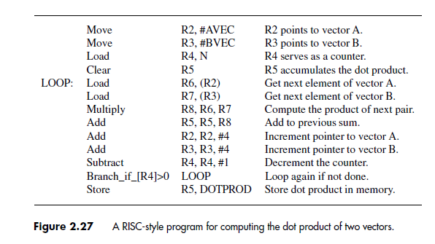
Continued…

Slide 48
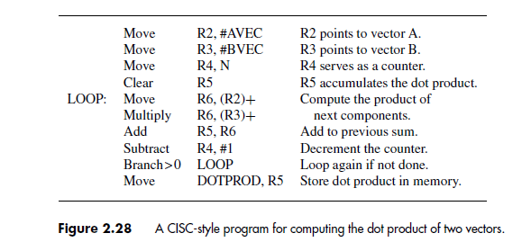
Continued…

